Slide 1
Introduction to Python Programming
- Kavita Tewani

Slide 2
Agenda
Syntax
Data Types

Slide 3
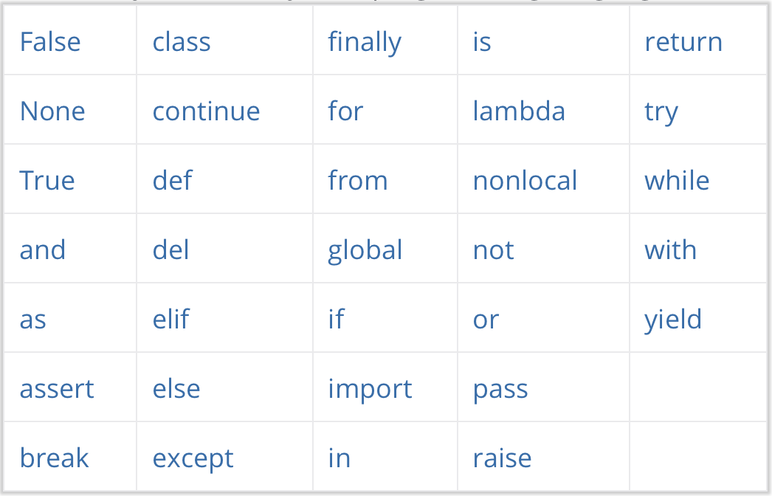
Python Keywords

Slide 4
Python Identifiers
Identifier is a name used to identify a variable, function, class, module or other object
An identifier starts with a letter A to Z or a to z or an underscore (_) followed by zero or more letters, underscores and digits (0 to 9)
Python does not allow punctuation characters such as @, $, and % within identifiers
Identifiers are case sensitive

Slide 5
Python Indentation
In most other programming languages the indentation in code is for readability only, in Python the indentation is very important
Python uses indentation to indicate a block of code
Following code creates a block under if statement
if 5 > 2:
print("Five is greater than two!")
While this code generates error
if 5 > 2:
print("Five is greater than two!")

Slide 6
Comments and Help
Python Comments:
Comments start with a #, and Python will render the rest of the line as a comment
#This is a comment.
print("Hello, World!")
Docstrings
"""This is a
multiline docstring."""
Help in Python: help(topic)
If no argument is given, the interactive help system starts on the interpreter console. If the argument is a string, then the string is looked up as the name of a module, function, class, method, keyword, or documentation topic, and a help page is printed on the console.

Slide 7
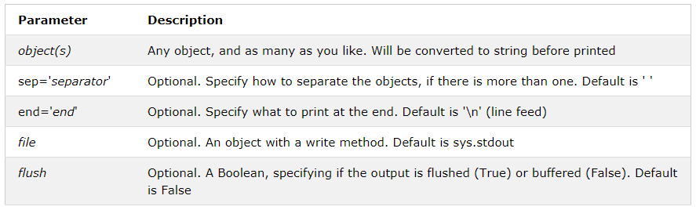
Printing in Python
Syntax: print(object(s), sep=separator, end=end, file=file, flush=flush)

Slide 8
Two other methods to print
.format() method
Syntax: print(“Hello this is {} and {}”.format(a,b)
f-string (formatted string literal) – newer version of Python 3
Syntax: print(f”Name is {name} and age is {age}”)

Slide 9
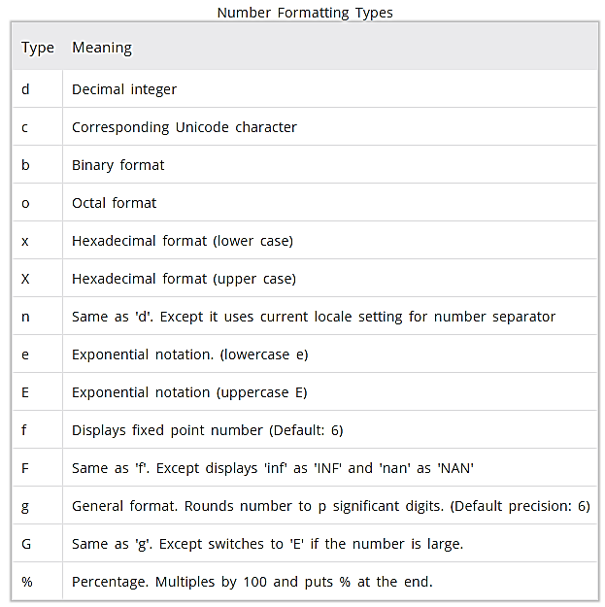
Number Formatting types

Slide 10
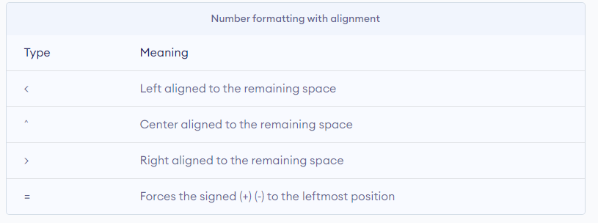
Printing- Padding and Alignment

